Slide 1
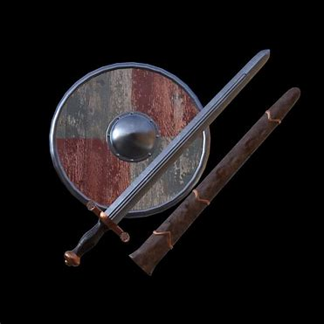
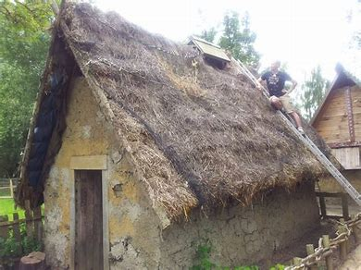
The Vikings
By Alana Mullin

Slide 2
Where did the Viking come from?
The Vikings were from regions of Scandinavia, such as Sweden, Denmark, and Norway. Many of the Vikings settled in the British Isles and what is now known as northern France. The Vikings that settled in northern France broke from their brothers and became known as Normans.

Slide 3
Find information about a Viking house
The Vikings built longhouses all over Scandinavia. The typical Viking longhouse was 6 metres wide and up to 75 metres long, with a wooden frame, and walls of wooden planks or clay.
The Viking longhouse was usually divided into several different rooms. Several families lived in the same house, and the more important families lived closer to the fire.
Fires were built in a central passageway to provide light and heat, and a means of cooking food. The fire was kept burning almost constantly, especially in colder areas.
Stone lamps using fish liver oil or whale oil were sometimes used in longhouses, providing a strong enough light to work by

Slide 4
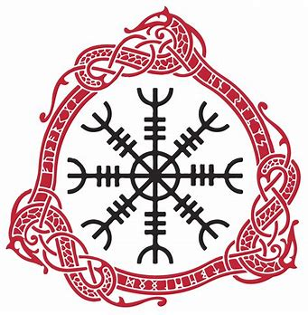
Design a Viking house based on information gained
Viking houses were built of wood. The longhouses had bowed walls in plan, forming a ship-like outline. The walls were lined with clay or consisted of wooden planks placed vertically into the ground, which supported the roof, along with two rows of internal posts. Outside the house was often supported by sloping posts. Roofs were slanted and could be thatched or wooden.
In the middle of the house was an oblong fireplace – the long fireplace. Here the food was made. Along the walls there were plank beds, on which the Vikings could sit or sleep. At one end of the house the animals were housed in stalls, if there were no stables at the farm.

Slide 5
My Viking house
This is my Viking house I made today.

